Slide 1
Practical Dark Web Hunting using Automated Scripts

Slide 2











$whoami
Apurv Singh Gautam (@ASG_Sc0rpi0n)
Threat Researcher @
Cybersecurity @ Georgia Tech (Go Jackets)
Presented at conferences
Hobbies
Hiking
Lockpicking
Gaming/Streaming
Social
Twitter - @ASG_Sc0rpi0n
Website - apurvsinghgautam.me

Slide 3

Agenda
Why focusing on the Dark Web?
Methods to hunt on the Dark Web
Lab Time
Scraping Defenses Discussion
OpSec? What’s that?
Conclusion
Notes:
People skills
Technology Skills

Slide 4
1. Why focusing on the Dark Web

Slide 5

Why So Serious (Eh! Important)?
Hacker forums, darknet markets, dump shops, etc.
Criminals can learn, monetize,
trade, and communicate
Identification of compromised assets
Can potentially identify attacks in
earlier stages
Direct impacts – PII (Personal Info),
financial, EHRs (healthcare records), trade secrets
Indirect impacts – reputation, revenue loss, legal penalties
Notes:
Learn – criminals learn new methods and techniques
Monetize – monetize their skills
Trade – trade their exploits/tools, drugs, weapons
Communicate – communicate with other criminals
Can learn a lot on engaging with these communities
The intelligence from dark web isn’t available anywhere else
Identify attackers,
vulnerability prioritization
in planning and recon stages
Takes a lot of time, If done properly, it can even identify attacks in planning and recon stages

Slide 6
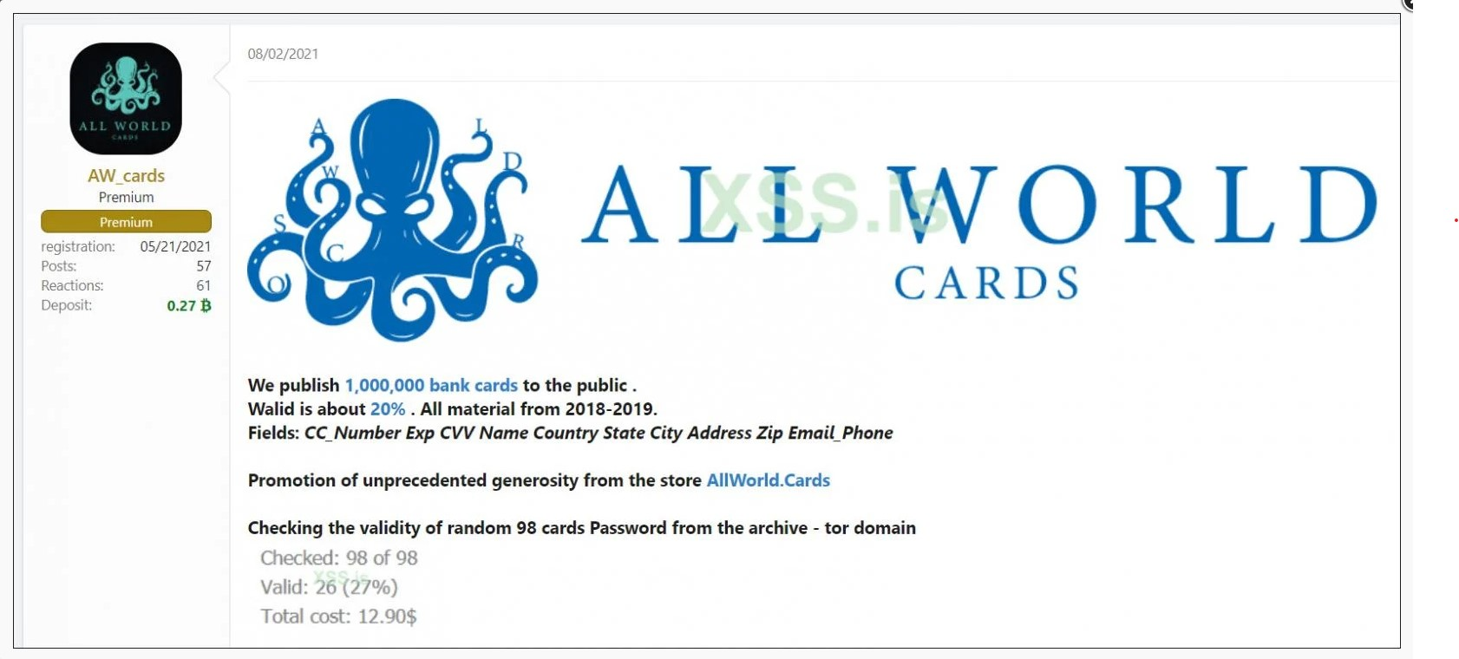
Why should you care?
Notes:
Bank data – credit cards
Released 1M credit cards for free – 20% still valid (200k)
Several banks all over the world affected

Slide 7
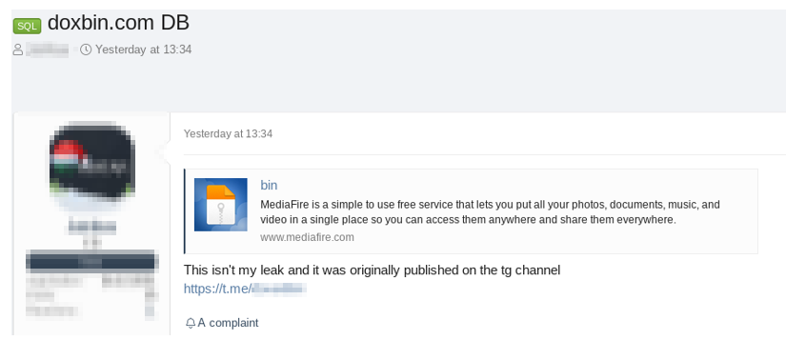
Why should you care?
Notes:
PII data
Doxbin is a website used for leaking Personally Identifiable Information (PII), or “dox,” of any person of interest.
PII including some TA’s also

Slide 8
2. Methods to hunt on the Dark Web

Slide 9
Readily Available Tools
Search Engine tools
Onion Link Collection tools
Onion Link Scan tools
Onion Link Scraping tools
All tools available at: https://github.com/apurvsinghgautam/dark-web-osint-tools
Notes:
You can start contributing to these tools

Slide 10
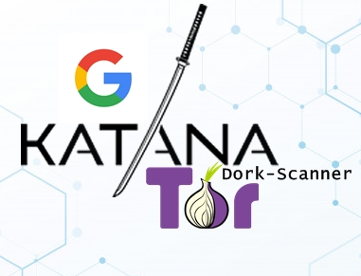



Search Engine Tools
Katana
Onionsearch
Ahmia Search Engine
Darksearch
Image Sources: Katana, OnionSearch, Ahmia, DarkSearch

Slide 11

Onionsearch
Notes:
Built in multithreading
16 search engines
Threads can be tuned

Slide 12
Onionsearch (Contd.)
Notes:
Search engine, title of the webpage, onion link

Slide 13

Onion Link Collection Tools
Hunchly
Tor66
r/onions
Image Sources: Hunchly

Slide 14
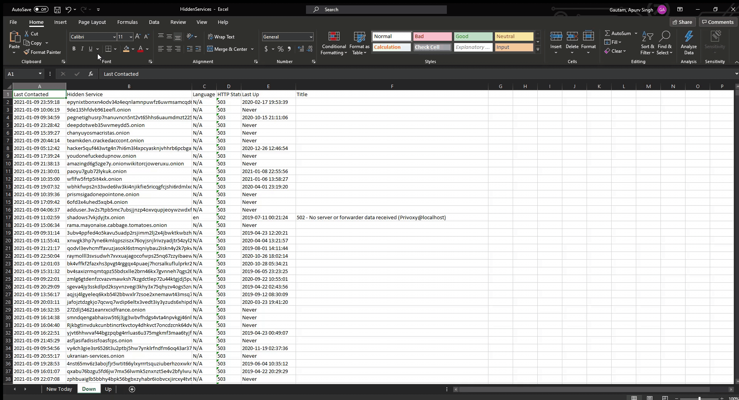
Hunchly

Slide 15

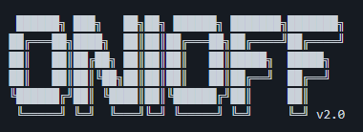
Onion Link Scan Tools
OnionScan
Onioff
Onion-nmap
Image Sources: OnionScan, Onioff

Slide 16

OnionScan
Notes:
Scan for visible pages
Scan for vulnerabilities
Scan for services
Released a correlation lab -> to check correlations between different onion sites

Slide 17
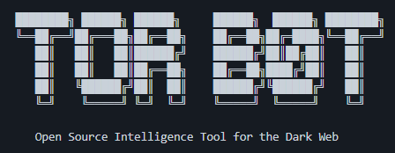

Onion Link Scraping Tools
TorBot
TorCrawl
OnionIngestor
Image Sources: TorBot, OnionIngestor

Slide 18
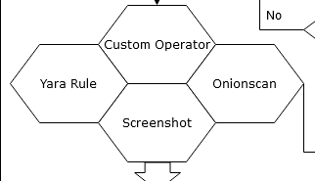
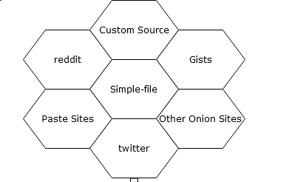
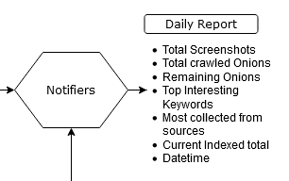
OnionIngestor
Notes:
Sources
Operators
Stored in Elasticsearch

Slide 19
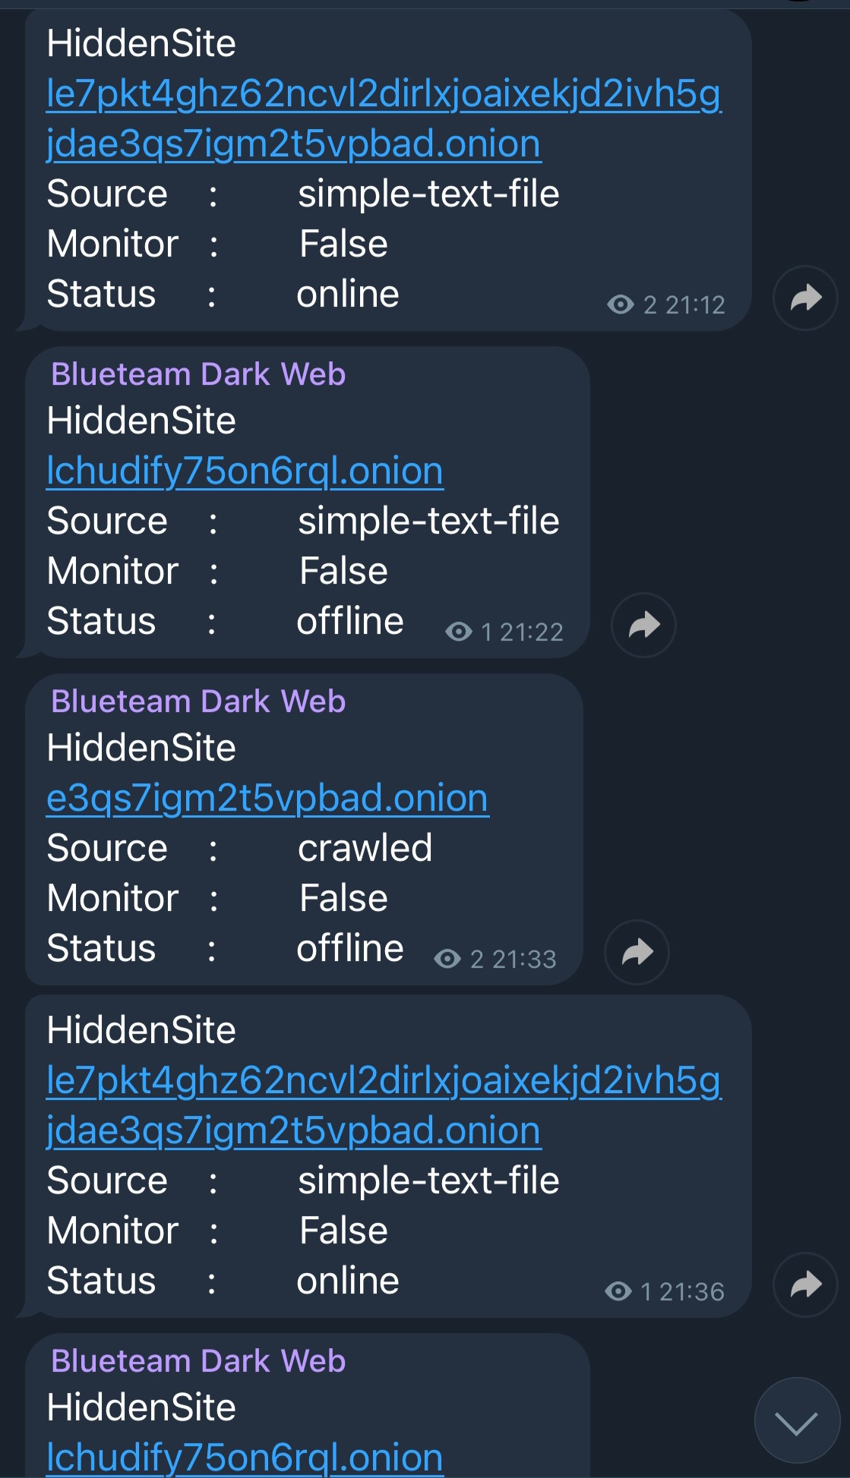
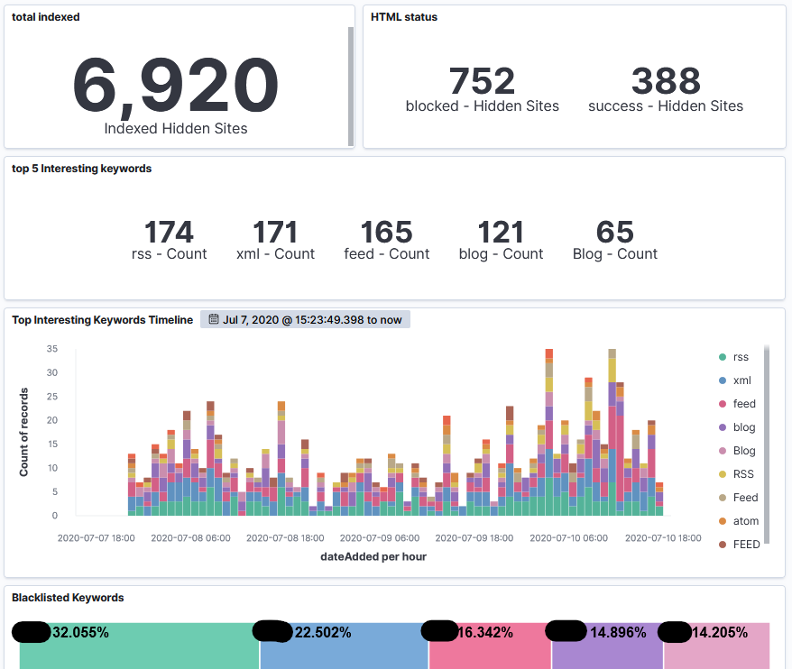
OnionIngestor (Contd.)

Slide 20
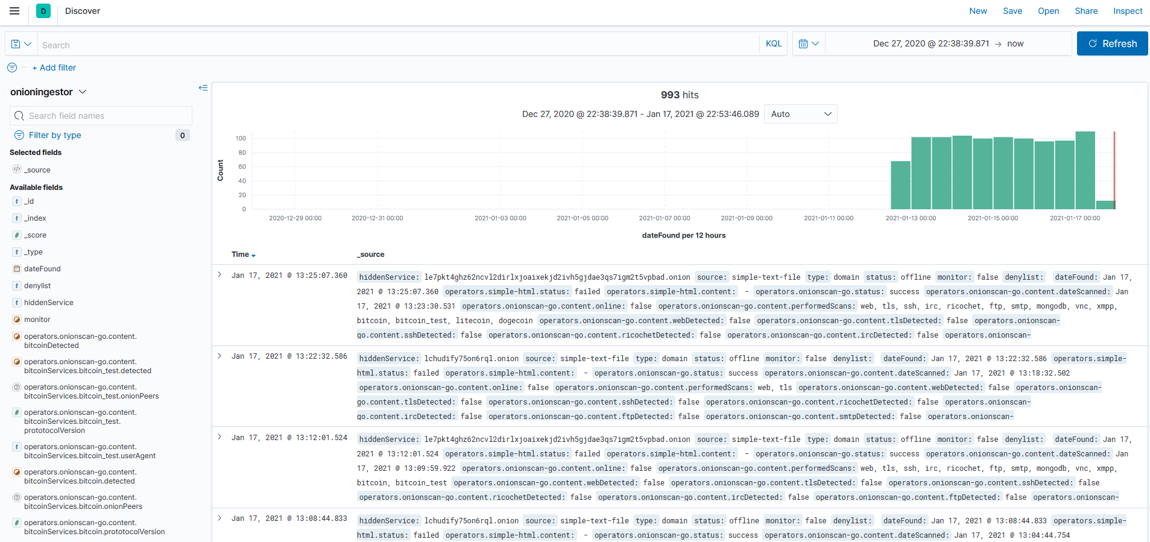
OnionIngestor (Contd.)

Slide 21




Create your own tools
Scrapy
Tor
OnionScan
Privoxy
Elastic
and many more…
Image Sources: Tor Project, OnionScan, Scrapy, Privoxy, Redis
Notes:
Scrapy - web-crawling framework - multithreading capability
OnionScan - open source tool for investigating the Dark Web, scanning different onion sites for vulnerabilities, correlations between sites, etc
Different ways of using socks proxy – tsocks, polipo, Privoxy, etc.
Privoxy – web proxy – scrapy cannot use socks proxy so route through Privoxy (tor with socks – layer of protection) - to hide using tor from your ISP
Use VPN + SOCKS for extra protection - hide your activity and get real safe access - can’t trust entry and exit nodesTorch
Onion Wiki
Search engines like Kilos, Recon

Slide 22
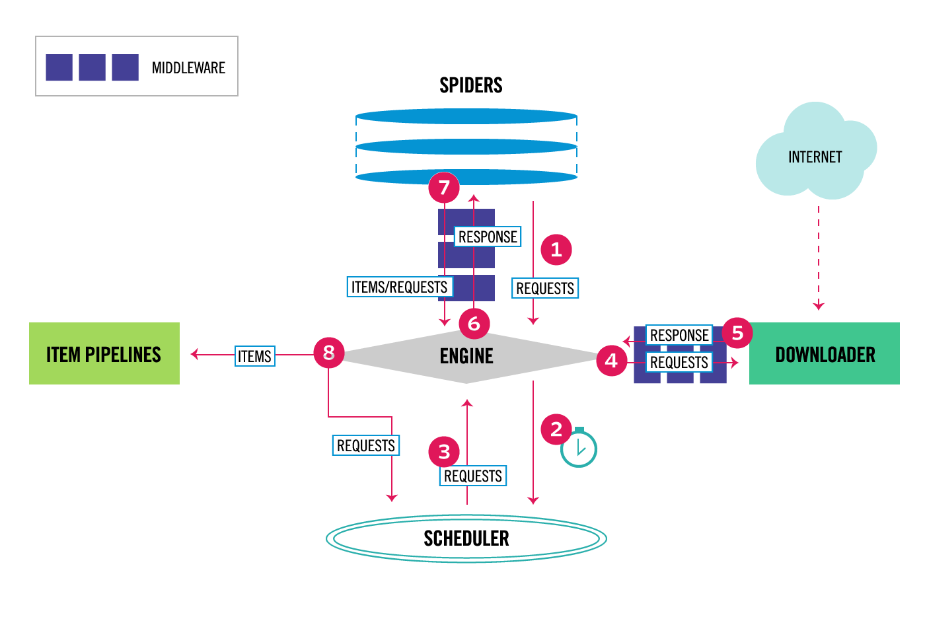
How Scrapy Works?
Image Source: Scrapy Docs
Notes:
1. The Engine gets the initial Requests to crawl from the Spider.
2. The Engine schedules the Requests in the Scheduler and asks for the next Requests to crawl.
3. The Scheduler returns the next Requests to the Engine.
4. The Engine sends the Requests to the Downloader, passing through the Downloader Middlewares
5. Once the page finishes downloading the Downloader generates a Response (with that page) and sends it to the Engine, passing through the Downloader Middlewares
6. The Engine receives the Response from the Downloader and sends it to the Spider for processing, passing through the Spider Middleware
7. The Spider processes the Response and returns scraped items and new Requests (to follow) to the Engine, passing through the Spider Middleware
8. The Engine sends processed items to Item Pipelines, then send processed Requests to the Scheduler and asks for possible next Requests to crawl.
9. The process repeats (from step 1) until there are no more requests from the Scheduler.
Middlewares – ProxyMiddleware(relaying through Privoxy and tor), LoginMiddleware (using user_agent, cookies/bypassing captchas, checking login), Captcha solving websites - deathbycapthca, anticaptcha, etc

Slide 23
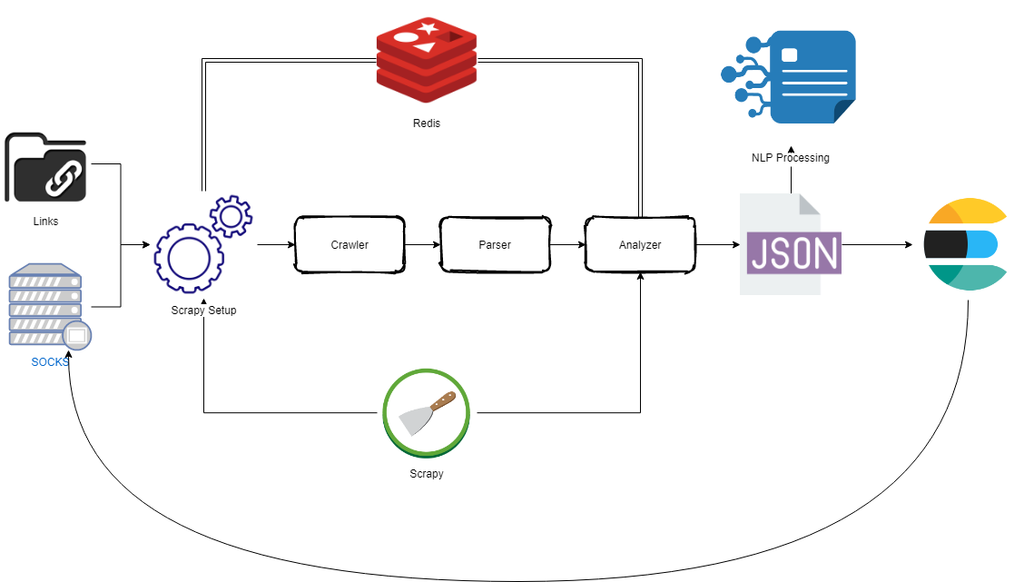
Automated Hunting Architecture
Notes:
Dark web links – collect forum/DNMs links
Tools like OnionIngestor – collect onion links from various sources
Socks proxies – run socks proxy script to collect several socks proxies to route tor through them
Different crawlers for different forums
Scrapy setup – setup login for each forum, setup several settings including headers, cookies, ignored links, captcha bypass, etc
Crawler - crawls html pages of the forums
Parser – parses html pages (taking only relevant texts from the html) – post_id, post_content, post_author, author_status, reputation, item_price, etc.
Analyzer – uses NLP techniques to evaluate the content that is relevant to the threat model and stores them into the ES database.
Design/Train NLP model – design and train NLP model on the content that is relevant to your threat model and apply it on new data
Egg and chicken problem (data gathering vs training on data)
Many unsupervised learning models – lda, seeded lda, etc.

Slide 24
3. Lab Time

Slide 25
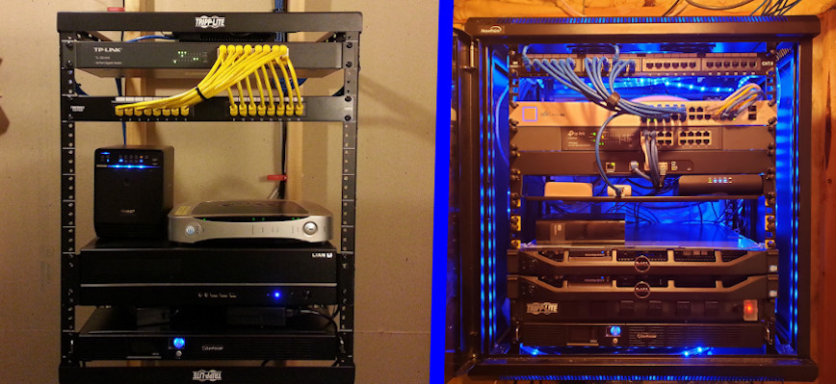
Setting up a Lab
Lab/VM
Physical or Cloud
Isolate the network
Install relevant tools
Go
Scrapy
Privoxy
Tor
ELK
Go libraries
Python libraries
Image Source: Hayden James

Slide 26
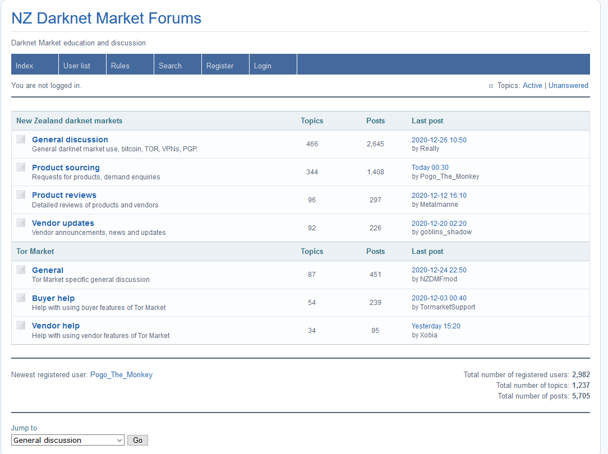
NZDarknet Forum
Notes:
Acts as abstract class for other spiders

Slide 27
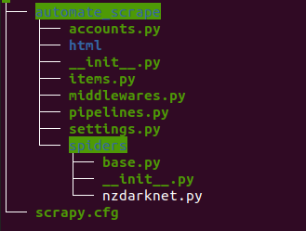
Tree Structure

Slide 28
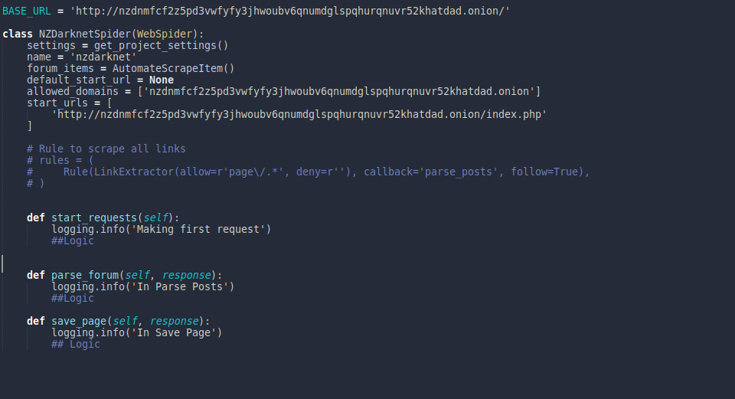
nzdarknet.py

Slide 29
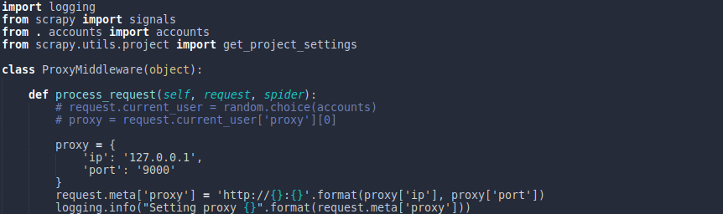
middlewares.py
Notes:
You can put cookie middleware or put login code in spider itself
If it is only one spider then you can put login code in middleware also

Slide 30
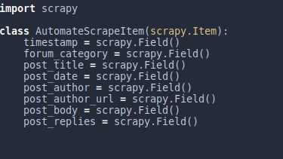
items.py
Notes:
Basically a dictionary

Slide 31
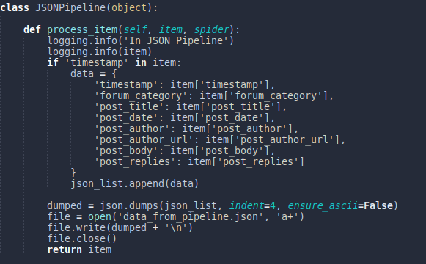
pipelines.py
Notes:
Can add multiple pipielines like ES and SQL pipeline

Slide 32
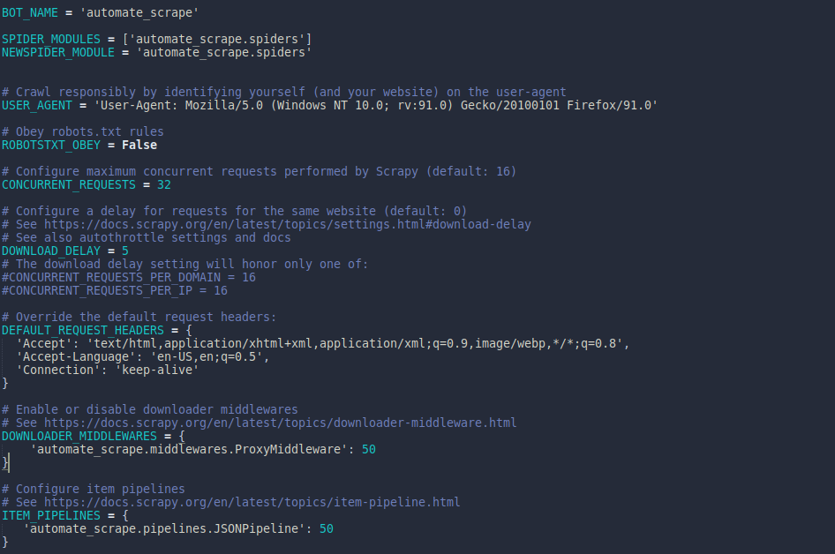
settings.py

Slide 33
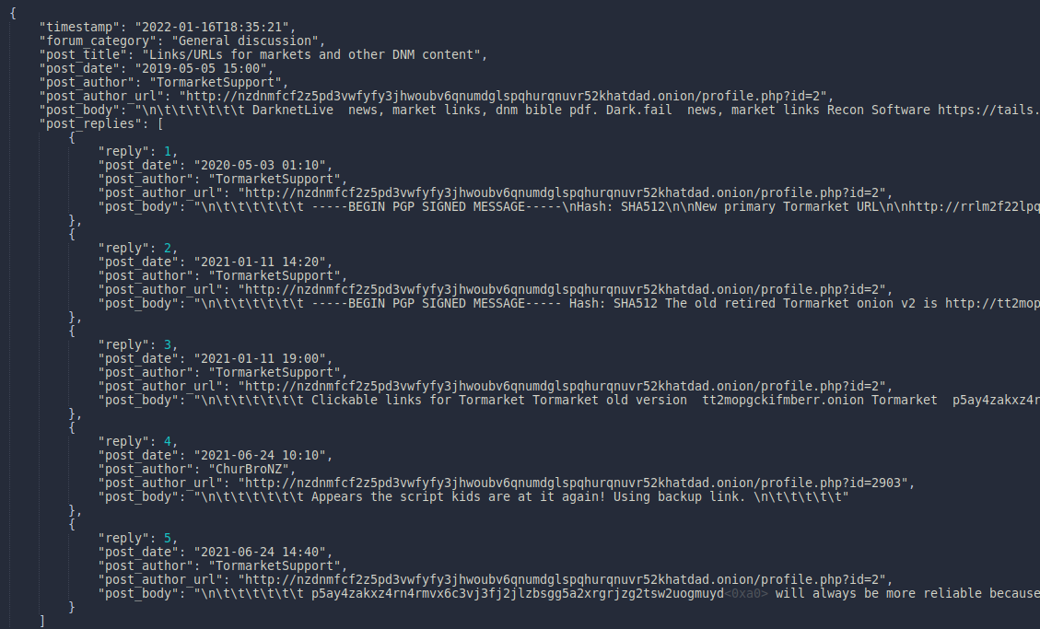
Sample JSON Data

Slide 34
4. Scraping Defenses Discussion

Slide 35
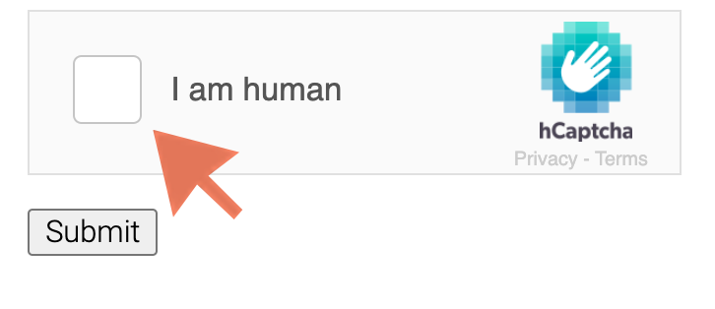
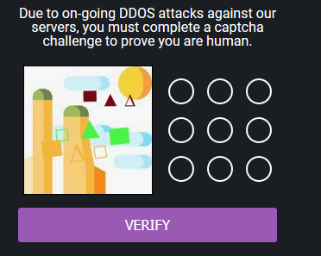
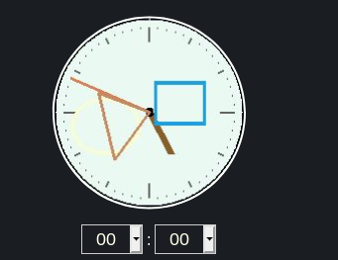
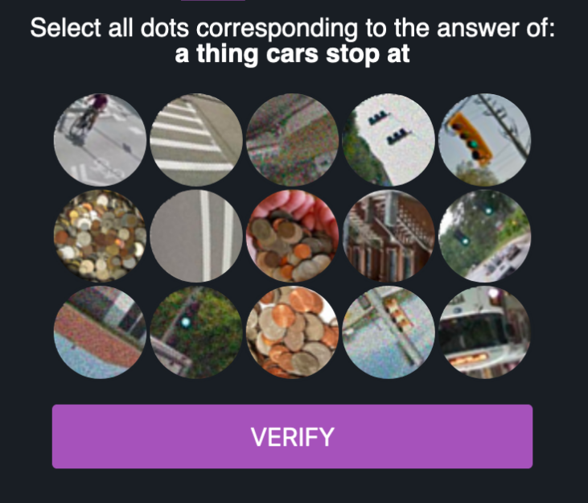
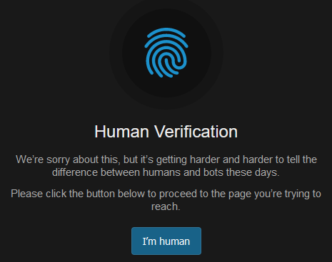
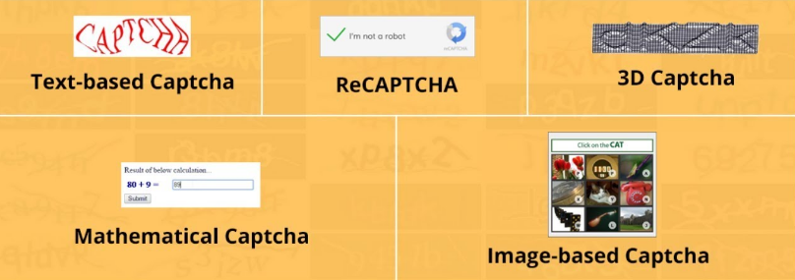
What defenses do sites put?
DDoS Protection
Captcha System
JavaScript Enabled Sites
IP blocking
Account blocking
Cookie Change
Notes:
DDoS protection – implementing wait times before opening a site
Cookie Change – changing cookies very quickly

Slide 36


Circumventing Scraping Defenses
Setting Delays
Captcha Bypass Services
Using Selenium
Rotating IPs (SOCKS 4/5)
Rotating Accounts
Utilizing Cookies
Notes:
Talk about captcha bypass (captcha solving services like deathbycapthca, anticaptcha, etc.)
Use selenium with headless browser
Viable techniques:
Captcha bypass for harder captchas?
Cookie change?
Feasilble Defenses??
Rotating Ips - https://stackoverflow.com/questions/64835702/how-to-run-multiple-tor-privoxy-processes-for-scrapy-with-different-ips-at-the-s

Slide 37
5. OpSec? What’s that?

Slide 38

What is OpSec?
Actions taken to ensure that information leakage doesn’t compromise you or your operations
Derived from US military – Operational Security
PII – Personally Identifiable Information
Not just a process – a mindset
OpSec is Hard
Notes:
the practice of hiding yourself online by disassociating your online persona with your real self
We are all humans
We desire to be seen knowledgeable and to impress others
Leads to gossip, brag, and overshare
PII – personal information that can identify you – full name, SSN, driver’s license, bank account, email, passport number, etc.

Slide 39

Maintaining OpSec in your lifestyle
Use VM/Lab or an isolated system
Use Tor over SOCKS or VPN
Change Time zones
Maintain different persona
Use password manager
Clean/Wipe data from VM
Say NO to personal info
Notes:
You have to do opsec from the beginning/proactivly because you can't do opsec "retroactively"
Never store any personal information on the VM or the system you are accessing dark web from
Clean/Wipe all the data before leaving the system and start fresh the other day
Have different persona on different sites, don’t mix it., Have a back story for each personas

Slide 40
6. Conclusion

Slide 41
What we discussed so far?
Why Dark web hunting is important
Tools needed to hunt data on the Dark Web
OSINT Tools
Methods to create your own scripts
Automating the data collection
Scraping defenses circumvention

Slide 42
I don’t know how to conclude but..
Keep OpSec in mind
Look at more than one resource/site
Takes a lot of resources and team effort
Unique ways to create your automated architecture
Notes:
You don’t get the intelligence from anywhere else
Look at more forums
Adding Telegram notification in middleware
Full page screenshot - https://stackoverflow.com/questions/41721734/take-screenshot-of-full-page-with-selenium-python-with-chromedriver
Duplicate pipeline - https://docs.scrapy.org/en/latest/topics/item-pipeline.html

Slide 43
Resources
Read White papers & blogs from different security organizations
Follow people on LinkedIn and Twitter
Follow hashtags - #darkweb, #threatintelligence
Search Terms – darkweb, tor, deepweb, cybercrime forums
OSINT Framework - https://osintframework.com/
OSINT Combine Dark Web Searching - https://www.osintcombine.com/post/dark-web-searching

Slide 44
Resources (Contd.)
Jake Creps Blog - https://jakecreps.com/2019/05/16/osint-tools-for-the-dark-web/
DEFCON Recon Village - Ambly the Smart Darknet Spider talk by Cytisus Eurydice (@levitannin)
Darkweb Cyber Threat Intelligence Mining by Cambridge University Press
Notes:
Add blogs in the search terms

Slide 45

Thanks!
Any questions?
You can contact me at:
Twitter: @ASG_Sc0rpi0n
LinkedIn: /in/apurvsinghgautam

